Slide 1

Biodiversity in National Parks
Notes:
This presentation was automatically generated by PowerPoint Copilot based on content found in this document: https://cotecconsgroupvn-my.sharepoint.com/personal/hoangdd_coteccons_vn/Documents/N.%20Misc/11.%20Jupiter%20Notebook/21.%20Biodiversity%20starter/240501%20Biodiversity%20Analysis.docx AI-generated content may be incorrect.

Slide 2
Agenda
Loading the Data
Calculations
What are the conservation statuses of the species?
Compare Mammals vs Birds
Compare Mammals vs Reptiles
Let's look closer at Mammals
Let's look at the Bats
Conclusions
A recommendation
Notes:
Agenda * Loading the Data * Calculations * What are the conservation statuses of the species? * Compare Mammals vs Birds * Compare Mammals vs Reptiles * Let's look closer at Mammals * Let's look at the bat * Conclusions * A recommendation

Slide 3
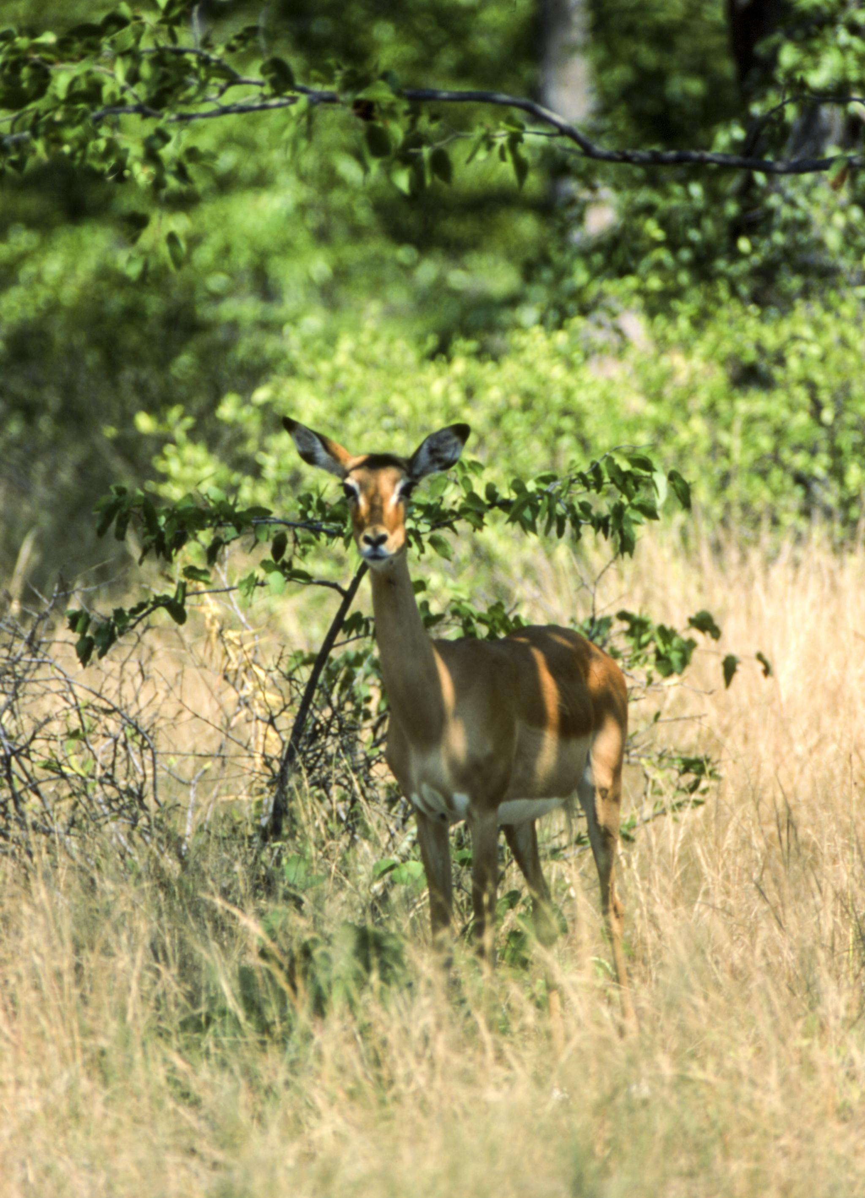
Loading the Data
Loading Datasets into DataFrames
Observations.csv and Species_info.csv
Explore and visualize data with Python
Species_info.csv Information
5,824 rows of data
Columns: category, scientific_name, common_names, conservation_status
Observations.csv Information
23,296 rows of data
Columns: scientific_name, park_name, observations
Notes:
In this section, we will load the datasets into DataFrames to analyze the conservation status of species and their observations in national parks. We will use Python to explore and visualize the data. The species_info.csv contains 5,824 rows of data, including columns such as category, scientific_name, and conservation_status. The Observations.csv contains 23,296 rows of data, including columns such as scientific_name, park_name, and observations. Original Content: Loading the Data To analyze the status of the conservation of species and their observations in national parks, load the datasets into DataFrames. Once loaded as DataFrames the data can be explored and visualized with Python. In the next steps, Observations.csv and Species_info.csv are read in DataFrames called observations and species respectively. The newly created DataFrames are glimpsed with.head() to check its contents. species The species_info.csv contains information on the different species in the National Parks. There are 5,824 rows of data. The columns in the data set include: · category - The category of taxonomy for each species · scientific_name - The scientific name of each species · common_names - The common names of each species · conservation_status - The species conservation status observations The Observations.csv contains information from recorded sightings of different species throughout the national parks in the past 7 days. There are 23,296 rows of data. The columns included are: · scientific_name - The scientific name of each species · park_name - The name of the national park · observations - The number of observations in the past 7 days

Slide 4
Calculations: What are the conservation statuses of the species?
5,541 species observed this week
7 categories of species in dataset
4 parks in dataset: Bryce National Park, Great Smoky Mountains National Park, Yellowstone National Park, Yosemite National Park
5 endangered statuses: Endangered, In Recovery, Species of Concern, Threatened, Not Endangered
96.72% of 5,824 species are not endangered, only 3.28% are endangered (191 species)
Endangered status: 7 mammals, 4 birds. In Recovery status: 3 birds, 1 mammal
Largest percentile of protected species: Mammals (17%), Birds (15%), Plants (2.5%)
Category | Size
Amphibian | 80
Bird | 521
Fish | 127
Mammal | 214
Nonvascular Plant | 333
Reptile | 79
Vascular Plant | 4,470
Notes:
This week, 5,541 species were observed. There are 7 categories of species and 4 parks in the dataset. There are 5 endangered statuses, with 96.72% of 5,824 species not endangered. The largest percentile of protected species are mammals, followed by birds and plants. Original Content: What are the conservation statuses of the species? · There have been 5,541 species observed this week. · There are 7 categories of species in this dataset. Include: · There are 04 parks in the data set: o Bryce National Park o Great Smoky Mountains National Park o Yellowstone National Park o Yosemite National Park · There are 05 endangered status: o Endangered: Seriously at risk of extinction. o In Recovery: Formerly Endangered, but currently neither in danger of extinction throughout all nor a significant portion of its range. o Species of Concern: Declining or appearing to need conservation. o Threatened: Vulnerable to endangerment soon. o Not endangered: Nan values (missing data) were detected. · Of 5,824 species, 5,633 are not endangered, which means 96.72% are not endangered, only 3.28% of the endangered species, equivalent to 191 species. · Show the number of species and the different categories of protection: For those in the Endangered status, 7 were mammals and 4 were birds. In the In Recovery status, there were 3 birds and 1 mammal, which could mean that the birds are bouncing back more than the mammals. · The largest percentile of protected species are mammals, with a close 2nd being birds. Mammals represent 17% of the protected species. Birds represent 15% of the protected species. Plants represent only 2.5% of the protected species.

Slide 5
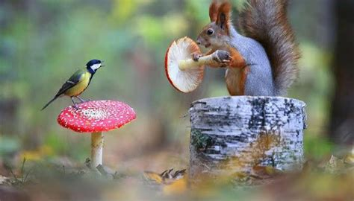
Calculations: Compare Mammals vs Birds
Comparison of protection status between Mammals and Birds
p-value of 0.688 is higher than significance level of 0.05
Null hypothesis is not rejected
Not enough evidence to say protection status is significantly related
Notes:
In this slide, we compare the protection status between Mammals and Birds. The p-value of 0.688 is higher than the significance level of 0.05, so we do not reject the null hypothesis. This means that we do not have enough evidence to say that the protection status and the type of Mammals and Birds are significantly related. Original Content: Compare Mammals vs Birds The p-value (0.688) is higher than the significance level (e.g., 0.05), so we do not reject the null hypothesis. We do not have enough evidence to say that the protection status and the type of Mammals and Birds are significantly related.

Slide 6
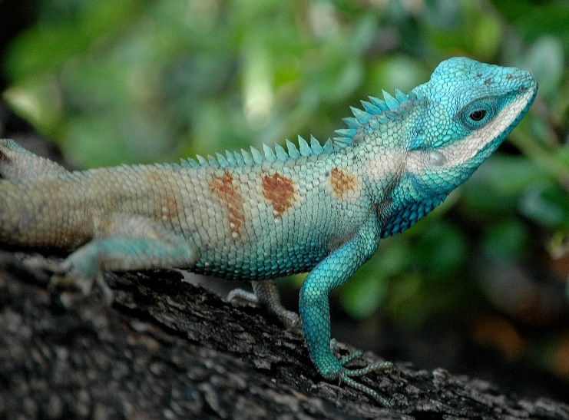
Calculations: Compare Mammals vs Reptiles
Comparison of protection rates between mammals and reptiles
p-value of 0.038 is smaller than significance level of 0.05
Null hypothesis not accepted
Evidence suggests higher protection rate for mammals
Notes:
In this study, we compared the protection rates between mammals and reptiles. Our results showed a p-value of 0.038, which is smaller than the significance level of 0.05. This means that we do not accept the null hypothesis and have enough evidence to suggest that the protection rate for mammals is higher than for reptiles. Original Content: Compare Mammals vs Reptiles The p-value (0.038) is smaller than the significance level (e.g., 0.05), so we do not accept the null hypothesis. We have enough evidence to infer that the protection rate for mammals is higher than the one for reptiles.

Slide 7

Let's look closer at Mammals
No. | Word | Count
1 | Bat | 23
2 | Shrew | 18
3 | Myotis | 17
4 | Mouse | 16
5 | Chipmunk | 13
6 | American | 12
7 | Squirrel | 12
8 | Eastern | 11
9 | Vole | 11
10 | Western | 10
Notes:
Let's take a closer look at mammals and learn more about them. Original Content: Let's look closer at Mammals

Slide 8
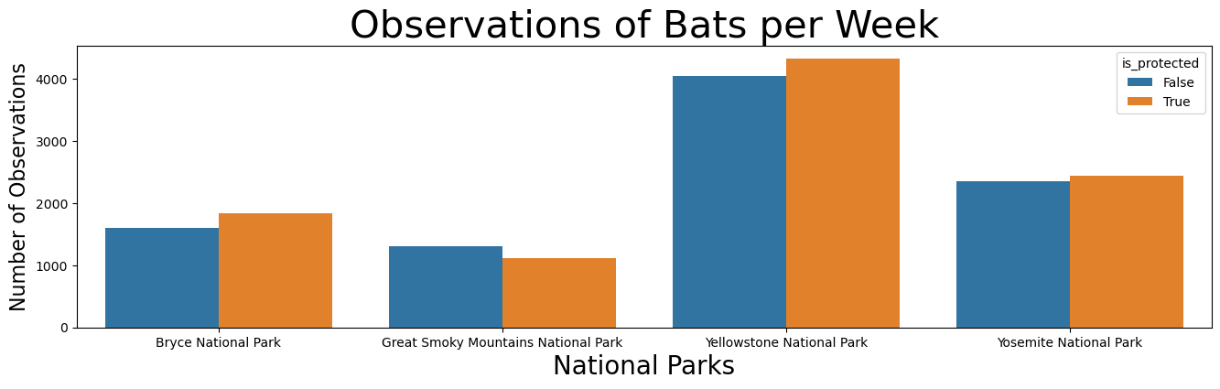
Let's look at the Bats
23 different bat species were observed this week
18,992 bats observed in total
9,708 of them are protected
51.12% of observed bats are in protected status
All parks have more protected bats except for Great Smoky Mountains National Park
Yellowstone National Park has the greatest number of bats
Notes:
This week, 23 different bat species were observed in National Parks, with a total of 18,992 bats. 9,708 of them are protected, making up 51.12% of the observed bats. All parks have more protected bats except for Great Smoky Mountains National Park, while Yellowstone National Park has the greatest number of bats. Original Content: Let's look at the bat · There are 23 different bat species observed this week at these National Parks. · There are 18,992 bats observed at these National Parks. · There were 9,708 protected bats, out of the 18,992 bats observed this week. · 51.12% of the bats observed are in a protected status. · All parks have more protected bats than unprotected bats, except for Great Smoky Mountains National Park. · Yellowstone National Park has the greatest number of bats.

Slide 9
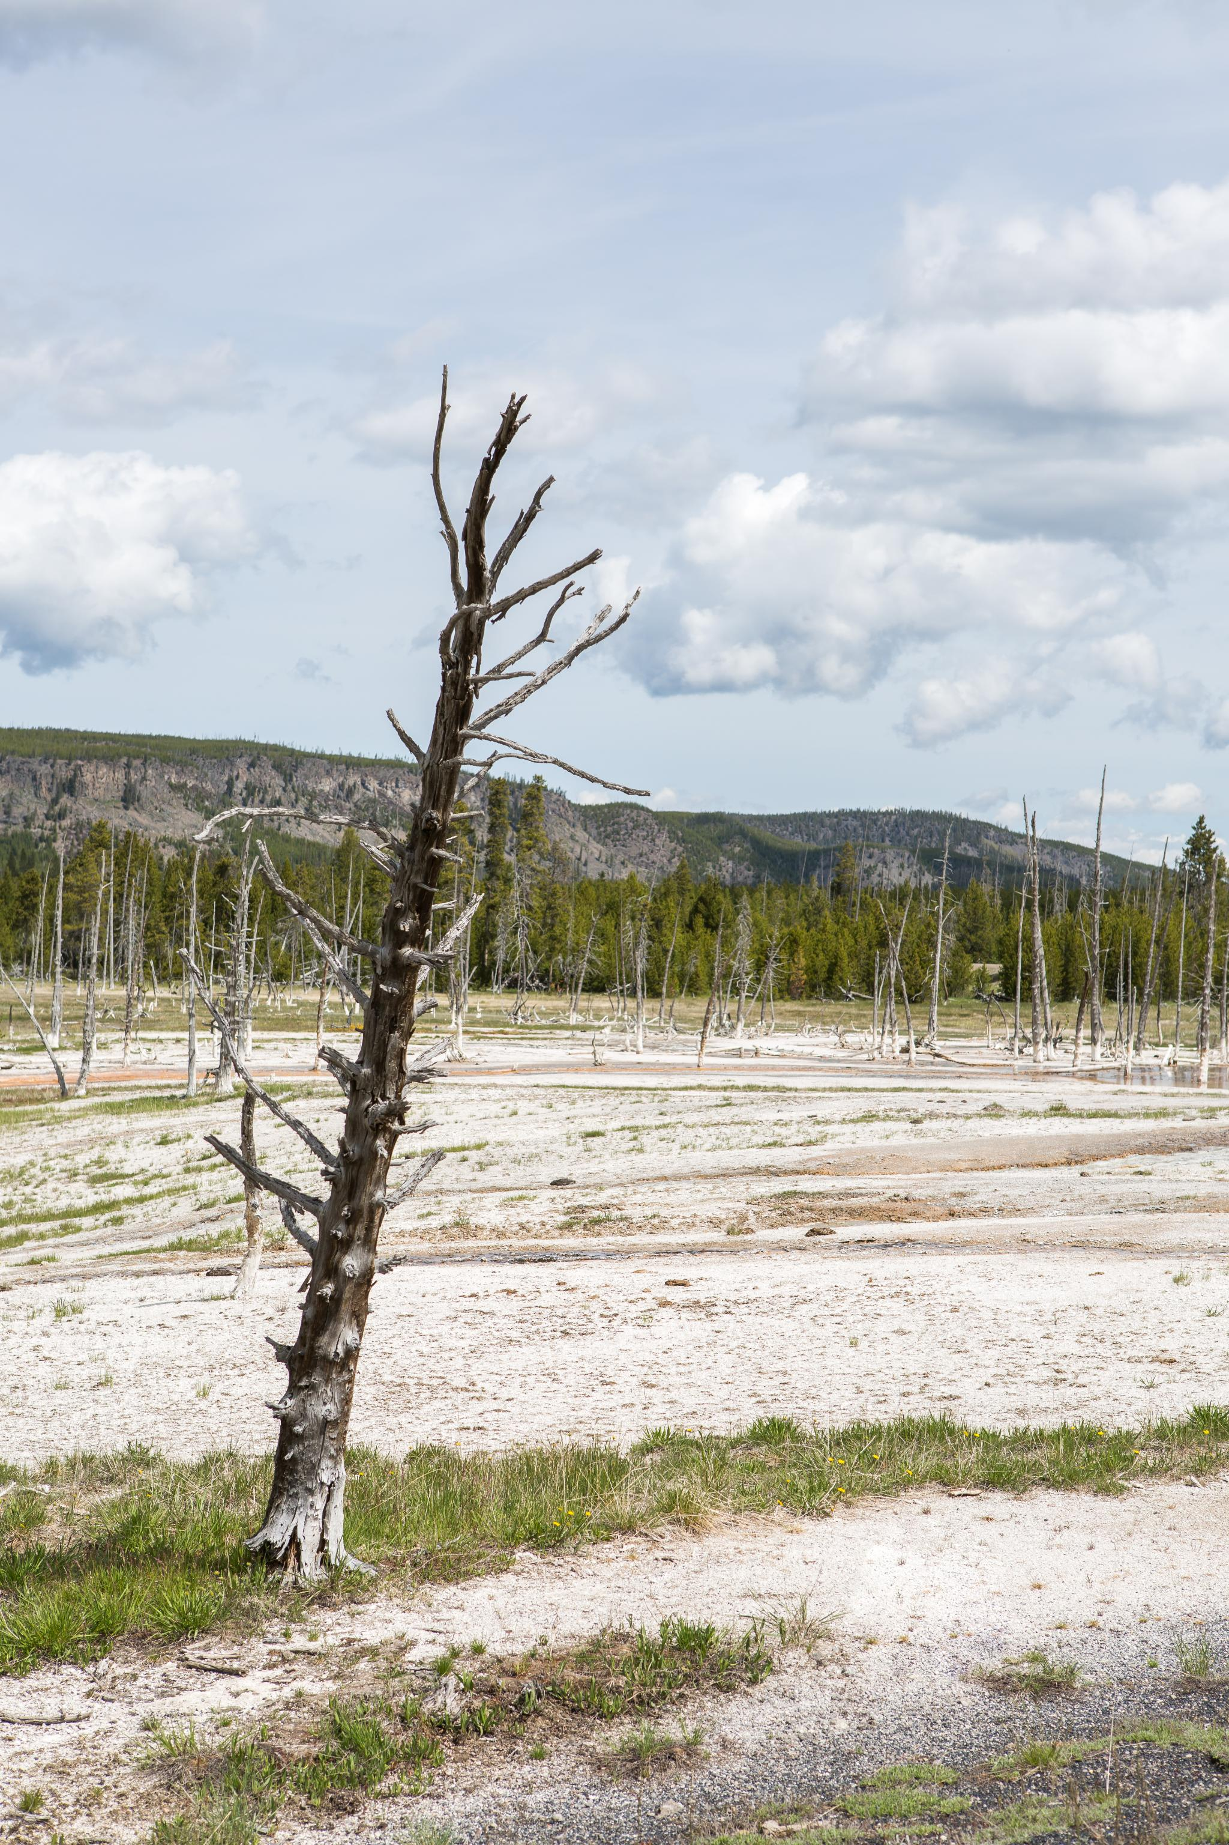
Conclusions
Distribution of conservation status for species: Majority not part of conservation (5,633 vs 191)
Mammals and Birds had the highest percentage of being in protection
The statistically significant difference in conservation percentage between mammals and reptiles
Bats occurred the most number of times and were most likely to be found in Yellowstone National Park
Notes:
The project made several data visualizations and inferences about species in four National Parks. The majority of species were not part of conservation. Mammals and Birds had the highest percentage of being in protection. There was a significant difference in conservation percentage between mammals and reptiles. Bats were the most prevalent and were most likely to be found in Yellowstone National Park. Original Content: Conclusions The project was able to make several data visualizations and inferences about the various species in four of the National Parks that comprised this data set. This project was also able to answer some of the questions first posed at the beginning. · What is the distribution of conservation status for species? o The vast majority of species were not part of conservation (5,633 vs 191). · Are certain types of species more likely to be endangered? o Mammals and Birds had the highest percentage of being in protection. · Are the differences between species and their conservation status significant? o While mammals and Birds did not have significant differences in conservation percentage, mammals and reptiles exhibited a statistically significant difference. · Which animal is most prevalent and what is their distribution amongst parks? o The study found that bats occurred the most number of times and they were most likely to be found in Yellowstone National Park.

Slide 10
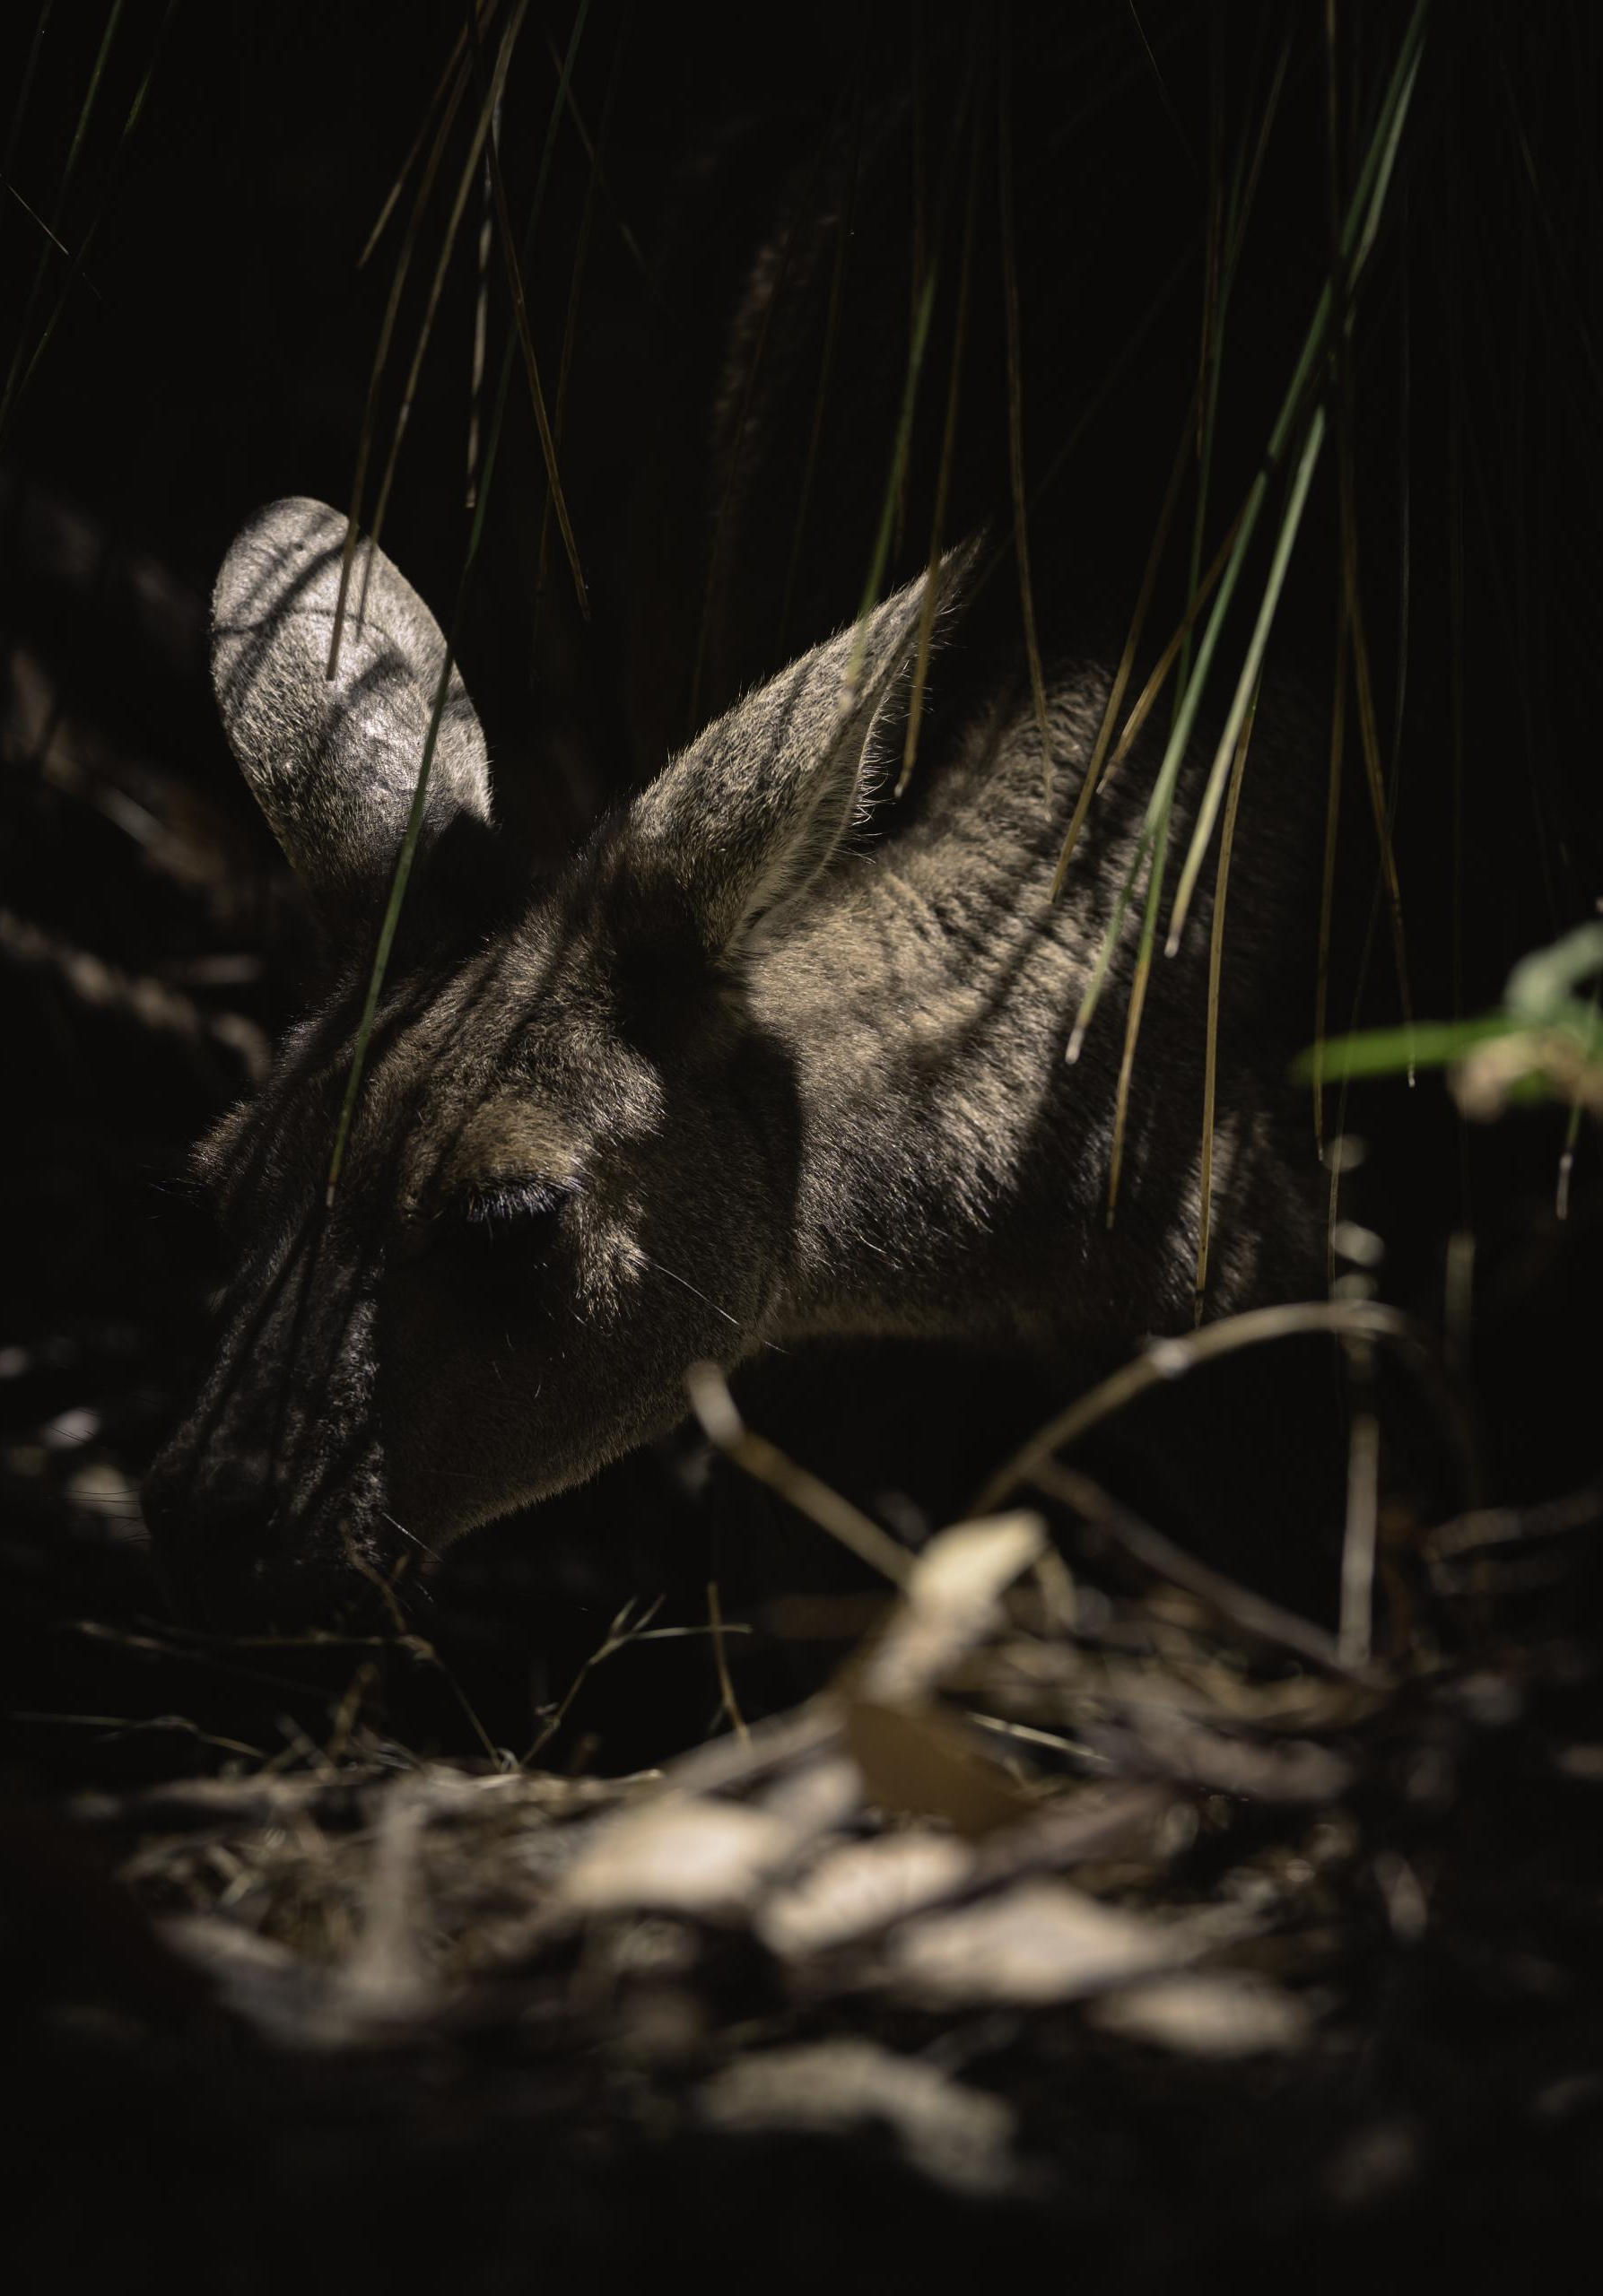
A recommendation
Protection of Mammals
Mammals are the most endangered species
Monitoring Bat Populations
Especially in Yellowstone National Park
Unprotected bats outnumber the protected ones
Notes:
Conservationists recommend prioritizing the protection of mammals, as they are the most endangered species. They also suggest monitoring bat populations, especially in Yellowstone National Park, where the number of unprotected bats is higher than the protected ones. Original Content: A recommendation Conservationists should prioritize the protection of mammals, as they are the most endangered category of species. We should also monitor the bat populations in the national parks, especially in Yellowstone National Park, where the unprotected bats outnumber the protected ones.

